Slide 1
Project Risk Management. CSE 406 Dr Samad Baseer DCSE. UET Peshawar

Slide 2

I
1
The Basics of Project Risk Management
S
K
2

Slide 3


After completing this lesson, you should be able to
Explain the concept of risk as it relates to project management, and list the advantages of managing project risks according to best practices.
Define uncertainty and risk and how they relate to each other
Differentiate between opportunity and threat risks
Describe how project stakeholders’ risk tolerance affects project management
Identify the benefits and obstacles to project risk management
List project risk management processes

Slide 4



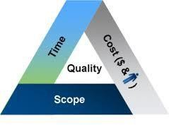
Risk is the probability of incurring some net loss while pursuing a goal.
Risk is the measurement of uncertainty.
According to the PMBOK Guide:
“Project risk is an uncertain event or condition that, if it occurs, has a positive or negative effect on one or more project objectives such as scope, schedule, cost, and quality”.
“A risk may have one or more causes, and, if it occurs, it may have one or more impacts”.
Risk is a means of measuring the quality of the project.
Uncertainty is a lack of knowledge about an event that reduces confidence in conclusions drawn from the data.
Not all risks are bad: Risks can present opportunities as well as threats to a project.

Slide 5






Project Risks
Threats or Negative Risks
Opportunities or Positive risks
Threats which occur called issues or problems, have a negative effect on the project objectives. E.g., Loosing critical resources from the project
Opportunities which occur may be called benefits, have a positive effect on the project objectives.
E.g., New resource that replacing the lost is a better one!
A project manager will proactively manage threats to the project and look for ways to reduce the probability or impact of the threat (Mitigate) or eliminate the threat all together
A project manager will proactively manage opportunities to the project and look for ways to exploit, enhance, or share the opportunity.
(avoid) or transfer to another party.

Slide 6
It is important to distinguish between causes risks, risks and the effects of risks.
Causes
Events or circumstances which currently exist in the project or are certain to exist in the future and which might give rise to risks. E.g., Never done a similar project
Risks
Are uncertain future events or conditions which may or may not occur, but which
would matter if they did occur. E.g., Client expectations may be misunderstood
Effects
These are unplanned variations from project objectives, either positive or negative, which arise as a result of risks occurring. E.g., Failing to meet contractual agreement
Structured risk statement (Meta-Language)
“Because our organization has never done a project like this before (fact = cause), we might misunderstand the customer's requirement (uncertainty = risk), and our solution would not meet the performance (effect)
6

Slide 7
Project risks may be known or unknown.
Known-unknowns: refer to those risks that we know have a probability of occurring, but do not know the precise impact it will have on the project.
Cannot be managed directly but can be mitigated by the use of contingency
Example: Key personnel leave project, Potential delay in delivery from third-party vendor, Development systems down, and etc.
Contingency reserve - This is the fund for “known-unknowns“.
Unknown-unknowns: Those risks that can and do occur, but are extremely difficult to identify in advance. Are those risks which you don’t anticipate.
Basically, you didn’t even identify the risk until it has occurred.
Examples: Corporate failures, natural disasters, acts of terrorism or war, major snowstorm and etc.
Management reserve - This is for the “unknown-unknowns“.

Slide 8
High
Unknown-Unknown
Uncertainty
Unknown-Known
Known-Known
Low
Knowledge
High

Slide 9









What is Project Risk (Cont’d)
Risk Factors: When looking at risk, one should determine
What
The probability that it will occur
Frequency How often the risk is expected to occur on the project
Impact The range of possible outcomes
Timing
When in the project lifecycle
the risk is likely to occur

Slide 10


Also, you should know the difference between the two following types of risk:
Business Risk Insurable Risk (Pure)
VS
The normal risk of doing business Represents only an opportunity for loss
Presents an opportunity for gain or loss
Should be insured
Should be managed:
▶ Plan
Divided into four categories:
▶ Property damage (fire, flood, wind)
▶ Identify
▶ Qualitative Analysis
▶ Quantitative Analysis
▶ Response
▶ Control
▶ Indirect consequential loss (cost of cleanup after a loss, disrupted business)
▶ Legal liability (injury to visitors)
▶ Personal injury (employee injuries;
worker compensation)

Slide 11

A risk is a potential event, which if it occurs, no longer becomes a potential problem, but an actual problem called an issue.
An issue is a situation or circumstance that has occurred, is occurring, or has a 100% probability of occurring; and will have a detrimental impact on a program’s schedule, cost, customer satisfaction, technical or quality objectives.
Issues can be initiated as a result of findings or failure to mitigate risks.
Risk | Issue
Risk is an uncertain event or event that might happen in future. | Issue is an event that has already occurred.
Once risk is identified, its impact should be analyzed and the response plan should be prepared. | Once the impact of Issue is analyzed, the same should be resolved or escalated.
Examples: Potential weather delays during construction | Examples: Two weeks of rain have delayed construction

Slide 12
It is useful to consider project risk at two levels: individual & overall risk
Individual Project Risk
Specific uncertain event or condition that, if it occurs, has a positive or negative effect on one or more project objectives, elements or tasks.
Day-to-day Project Risk Management focuses on these individual risk in order to enhance the prospects of a successful project outcome. ‰
Overall project risk
The effect of uncertainty on the project as a whole, arising from all sources of uncertainty, including individual project risks, representing the exposure of stakeholders to the implications of variations in project outcome, both positive & negative.
Risk is initially addressed during project planning by shaping the project strategy.
Risk should also be monitored and managed as the project progresses to ensure that the project stays on track and emergent risks are addressed.

Slide 13
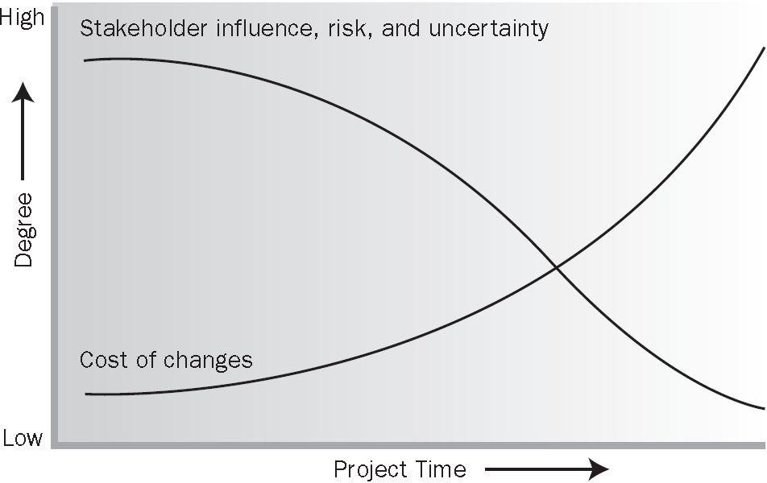
Project Life Cycle and Risk
More things are unknown at the beginning of a project, but risk must be considered in the initiation phase and weighed against the potential benefit of the project’s success in order to decide if the project should be chosen.
As the project progresses and more information becomes available to the project team, the total risk on the project typically reduces.
The cost of changes and correcting errors typically increases substantially as the project approaches completion.
The risk plan needs to be updated with new information and risks checked off that are related to activities that have been performed.

Slide 14
Project Life Cycle and Risk (Cont’d)
Iterative Process
Some risks will occur while others will not, new risks will arise or be discovered, and the characteristics of those already identified may change.
The Project Risk Management processes should be repeated and the corresponding plans progressively elaborated throughout the lifetime of the project.
To ensure that Project Risk Management remains effective, the identification and analysis of risks should be revisited periodically.
The progress on risk response actions should be monitored, and the action plans adjusted accordingly.
If external circumstances change significantly, it may also be necessary to revisit the risk management planning process.

Slide 15
Risk Attitude
Risk attitude is a disposition toward uncertainty, adopted explicitly or implicitly by individuals and groups, driven by perception, and evidenced by observable behavior.
The risk attitudes of both the organization and the stakeholders may be influenced by a number of factors, which are broadly classified into three:
Risk appetite – the degree of uncertainty an entity is willing to take on in anticipation of a reward.
Risk tolerance – the degree, amount or volume of risk that an organization or individual will withstand. Basically, tolerance is a range!
Risk threshold – measures along the level of uncertainty or the level of impact at which a stakeholder may have specific interest. A threshold is the point at which a risk becomes unacceptable.

Slide 16
Risk Attitude (Cont’d)
For example, the customer or sponsor may state that the budget is limited.
However, we do not have any strict deadlines.
It means that risk appetites for costs are low, while the schedule may take a higher level of risks.
On the other hand, they may say that we can take up to $10,000 of risks.
That is their tolerance for risks to budget.
Also if they say that we can not accept risks on more than 10,000 dollars.
That will be the risk threshold.
It is important to know these levels for sure.
It is wise to find out these values directly from stakeholders.

Slide 17
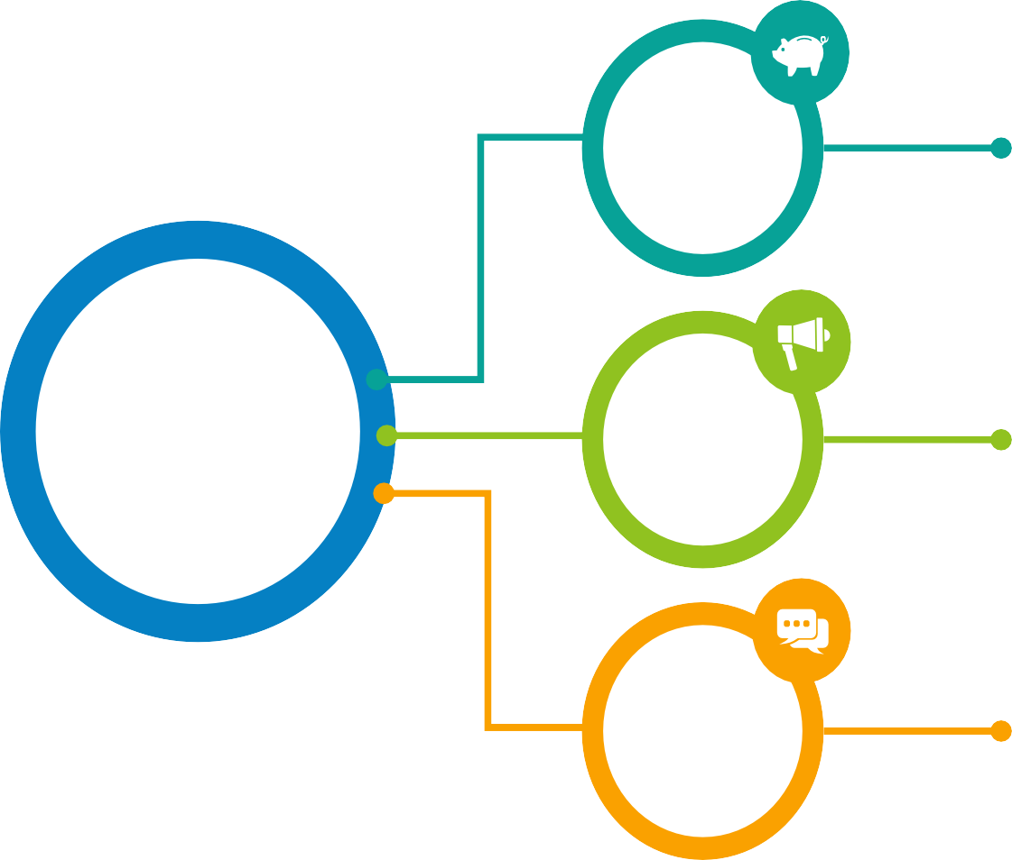
Risk Attitude (Cont’d)
Risk attitude exists on a continuous spectrum, but the common includes:
01
Risk Averse
Risk Averse people don’t like uncertainty. They intend to take path that is most certain even if it is least rewarding.
Risk Attitude
02
Risk Seeking
People who enjoy risk. They don’t worry too much about repercussions if the risk materialize. They are more focused on benefits they are going to get.
03
Risk Neutral
Risk Neutral people are quite calculative and they weigh all pros and cons before deciding to take risk or not.
17

Slide 18
Risk Attitude (Cont’d)
Understanding stakeholders risk attitudes is an important component of risk management planning that precedes risk identification and analysis, in order to optimize both project success and stakeholder satisfaction with the project’s results.
Attitudes should be identified and managed proactively and updated throughout the Project Risk Management process.
Attitudes may differ from one project to another for the same stakeholders
Attitudes usually differ from one group of stakeholders to another.
Single stakeholder may adopt different risk attitudes at various stages in the same project.
18

Slide 19

What is Project Risk Management
Project Risk Management includes the processes of conducting risk management planning, identification, analysis, response planning, response implementation, and monitoring risk on a project.
- It aims to identify and manage risks that are not addressed by the other project management processe
Risk Management
A proactive attempt to recognize and manage internal events and external threats that affect the likelihood of a project’s success.
What can go wrong (risk event)
How to minimize the risk event’s impact (consequences
What can be done before an event occurs (anticipation)
What to do when an event occurs (contingency plans)
19
s.
)
19

Slide 20
Trends and emerging practices for PRM include but are not limited to:
Non-event Risks
Most projects focus only on risks that are uncertain future events that may or may not occur. There is an increasing recognition that non-event risks need to be identified and managed. There are two main types of non-event risks:
Variability risk (also called “aleatoric uncertainty”), uncertainty exists about some key characteristics of a planned event or activity or decision. Examples: productivity may be above or below target, or unseasonal weather conditions may occur during the construction phase.
Ambiguity risk (also known as “epistemic uncertainty”), uncertainty exists about what might happen in the future arising from lack of knowledge or understanding. Examples: elements of the requirement or technical solution, future developments in regulatory frameworks, or inherent systemic complexity in
the project.
20

Slide 21
B. Project Resilience
The existence of emergent risk is becoming clear, with a growing awareness of so-called unknowable-unknowns.
The technical name for these risks is “ontological uncertainty,” but they are
more commonly known as “Black Swans” (Taleb, 2007).
These are risks that can only be recognized after they have occurred.
Emergent risks can be tackled through developing project resilience. This requires each project to have:
Right level of budget and schedule contingency
Flexible project processes
Empowered project team
Frequent review of early warning sign
Clear input from stakeholders in scope and strategy adjustments as emergent
risk response
21

Slide 22
C. Integrated Risk Management
Projects exist in an organizational context, and they may form part of a program or portfolio.
Risk exists at each of these levels, and risks should be owned and managed at the appropriate level.
Some risks identified at higher levels will be delegated to the project team for management, and some project risks may be escalated to higher levels if they
are best managed outside the project.
A coordinated approach to enterprise-wide risk management ensures alignment and coherence in the way risk is managed across all levels.
This builds risk efficiency into the structure of programs and portfolios, providing the greatest overall value for a given level of risk exposure.

Slide 23

D. Considerations for Agile/adaptive Environments
High-variability environments, by definition, incur more uncertainty and risk.
Projects managed using adaptive approaches make use of frequent reviews of incremental work products and cross-functional project teams to accelerate knowledge sharing and ensure that risk is understood and managed.
Risk is considered when selecting the content of each iteration, and risks will also be identified, analyzed, and managed during each iteration.
Additionally, the requirements are kept as a living document that is updated regularly, and work may be reprioritized as the project progresses, based on an improved understanding of current risk exposure.

Slide 24


Knowledge Area | Project Management Process Groups
 | Initiating | Planning | Executing | Monitoring & Control | Closing
Project Risk Management |  | Plan Risk Management Identify Risk Perform Qualitative Risk Analysis Perform Quantitative Risk Analysis Plan Risk Response |  | Monitor and Control Risks
Be careful! Risk are identified and managed starting in initiating and are continually kept up-to-date or added to while the project is underway. The project manager and the team look at what has happened on the project, the current status of the project, and what is yet to come and reassess the potential threats and opportunities.
24

Slide 25

Project Risk Management Processes (Cont’d)
A successful approach to risk management initiative and framework within an organization is known as PACED:
Embedded into the culture
Aligned to your
organization’s mission
of the organization and its
day-to-day activities
P
A
C
E D
Dynamic, iterative and responsive to change
Proportionate to the level of risk/ size of your organization
Complete, systematic and structured

Slide 26



4 Perform Quantitative
2
Identify Risks
6
Monitor and Control Risks
Determining which risks might affect the project and documenting their characteristics (Risk Register)
Risk Analysis
A numerical analysis of the
Monitoring your lists of risks to enact a risk response plan, to move a risk from one list to the other, or to remove a risk because it is no longer a risk. (Risk Register Update)
probability and impact of the risk on your project(Risk Register Update)
1
Plan Risk Management
Deciding how to approach, plan, and execute the risk management activities for a project (Risk management Plan). Who? When? What? How? How much?
3
5
Plan Risk Responses
Developing options and actions to Enhance
opportunities, and to reduce threats to
Perform Qualitative
Risk Analysis
Prioritizing risks for subsequent
further analysis or action by assessing and combining their probability of occurrence and impact (Risk Register Update), Ranking, Watch list.
project objectives. A course of action you will take to deal with your risks should they go from risk to issue.
Key Deliverable: Risk Related Contract Decisions.
26

Slide 27

Critical Success Factors for Project Risk Management
Integrate with Project Management
Recognize the value
of Risk Management
Risk Management Success
Scale Risk Effort to Project
Individual Commitment/ Responsibility
Organizational Commitment
Open and Honest Communication
27

Slide 28
Critical Success Factors for PRM (Cont’d)
Recognize the Value of Risk Management
Project Risk Management should be recognized because it provides a positive effects for:
Organizational management
Project stakeholders (both internal and external)
Project management
Team members
Individual Commitment/Responsibility
Project participants and stakeholders should all accept responsibility for undertaking risk-related activities as required. RM is everybody’s responsibility.
Open and Honest Communication
Everyone should be involved in the Project Risk Management process.
Any actions or attitudes that hinder communication about project risk reduce the effectiveness of Project Risk Management.

Slide 29
Critical Success Factors for PRM (Cont’d)
Organizational Commitment
Established if risk management is aligned with the organization’s goals and values.
Project Risk Management may require a higher level of managerial support because handling some of the risks will require approval of or responses from levels above the project manager.
Risk Effort Scaled to Project
Project Risk Management activities should be consistent with the value of:
Project to the organization
level of project risk and scale and Organizational constraints.
Integration with Project Management
Project Risk Management does not exist in a vacuum, isolated from other project management processes.
Successful Project Risk Management requires the correct execution of the other project processes.

Slide 30


Benefits of Project Risk Management
Help gain better understanding of the project
Ensures risks are considered early in the project management process
Provides increased confidence in investment and management decisions
Allows appropriate contingency plans or exit strategies to be put in place without the delay of figuring out what to do
Risks and responses can be documented as an historic record for future reference; helps learn lessons for the future
Enables more effective communication between partners and stakeholders about risk
Determine accountability and ownership
Increase the chance of project success
Peter Drucker “A decision that does not involve risk, probably is not a decision”

Slide 31
Barriers to Project Risk Management
01
02
03
Organization and the
stakeholders don't recognize the value
/benefits of risk management
06
Risk Management
Plan isn’t integrated in overall project plan.
Risk process too complex or overwhelming
No clear definition for project objectives
04
05
Unavailability of OPA which will consume more time to be developed
Too many team members and/or approval process
31

Slide 32
What is Project Manager’s Role in PRM
Encouraging senior management support for Project Risk Management activities.
Determining the acceptable levels of risk for the project in discussion with stakeholders.
Developing and approving the risk management plan.
Promoting & participating in all aspects of the Project Risk Management process.
Facilitating open and honest communication about risk within the project team and with management and other stakeholders.
Approving risk responses and associated actions prior to implementation.
Applying project contingency funds to deal with identified risks during the project.
Regularly reporting risk status to key stakeholders, with recommendations for appropriate strategic decisions and actions to maintain acceptable risk exposure.
Escalating identified risks to senior management where appropriate.
Monitoring the efficiency and effectiveness of the Project Risk Management process.
Auditing risk responses for their effectiveness and documenting lessons learned.

Slide 33


